Slide 1
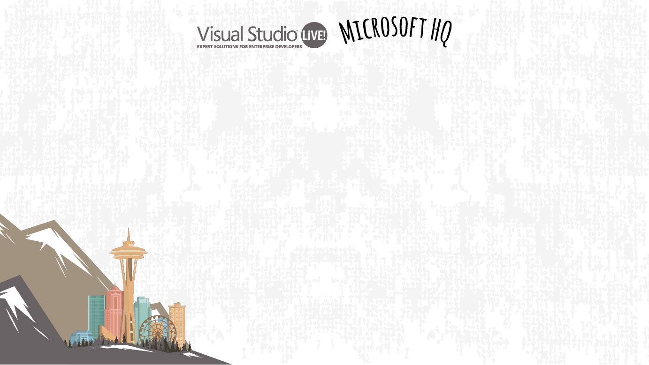
Application Modernization with Microsoft Azure
Michael Crump
E2E App Dev Experiences
Microsoft
Azuredev.tips
Level: Michael.Crump@Microsoft.com

Slide 2
Challenges
Applications
Data
Infrastructure
More resilient and scalable applications.
Adding new features and functionality without taking applications down.
Future-proof applications.
Data growth and data silos.
Incongruent data types.
Performance constraints.
Complexity of solutions.
Rising data maintenance costs.
Security and data breaches.
Actionable insights from data.
Heterogeneous workloads.
Hybrid deployments.
Security and management.
Continuous monitoring.
Cost management.
Notes:
In many cases, companies already have prior application investments that appear outdated, inflexible or are simply not up to the task because the technology and business environment has changed since they were built.
Many IT budgets are consumed by maintaining existing apps and resources and staying current with upgrades and migrations can deplete funding and resources before business benefits are realized.
If that is the case, such applications need to be re-vitalized and modernized to keep up with the current speed of business.
The growing requirements of our modern, digital business world can be a challenge for older applications – but there is a way to future-proof existing applications.

Slide 3
Are your applications ready?
Today
Future
Silo’ed applications, built in isolation
Multi-channel applications, covering all touchpoints
Limited set of platforms and form factors
Many platforms, devices and form factors
Overabundance of data
Data-driven intelligence in applications
Servers and infrastructure to manage
Focus on application functionality, not infrastructure
Upfront capacity planning, fixed scale
Elastic, unlimited scale
Notes:
As the business world moves into the digital space to meet the next generation of customers, employees and partners, create new efficiencies, and compete globally, organizations can’t view applications the same way as before – they must take them to the next level.
Are your applications ready for this new tomorrow?

Slide 4
Real-world questions
How can I make sure that my existing applications can take maximum advantage of cloud capabilities?
I’m worried that I need to start from zero and rebuild for the cloud?
How do I get started, I have so many apps!
Notes:
Many companies deal with a complex infrastructure grown over decades, need to support multiple platforms, and have many different types of data as well as highly customized legacy applications.
This causes a lot of uncertainty and questions about the best way to get applications to the cloud.
Let’s talk a bit more about the different paths on the application journey to the cloud.

Slide 5
The application journey to the cloud
Migration + Modernization
Notes:
Let’s take a closer look at the different migration and modernization options.
What differentiates Microsoft from other cloud vendors is that we meet you where you are on your cloud journey,
Whichever path and option you choose, we will be there to ensure you get the best outcome – across IaaS, PaaS, SaaS and even on-premises and any combination thereof.
We are the only cloud vendor that offers this broad set of capabilities.

Slide 6
The journey to the cloud
On-premises
b
Applications
Migration & Modernization
Cloud-Native
SaaS
Data + intelligence
Rehost
Refactor
Rearchitect
Rebuild/New
Replace
Infrastructure
Virtual Machines
Containers
App, Data, & AI Services
DevOps
Notes:
There is one journey, but each application can take a radically different path to get to the cloud.
Options range from migration – moving the application, its infrastructure and data as-is to the cloud – through modernization - where an app is modified to better take advantage of the cloud - to re-building where the app is recreated using a cloud-native approach.
Gartner has a more granular model comprised of rehost, refactor, rearchitect and rebuild. They break down modernization into refactoring – moving an app to containers without changing it – and rearchitecting which requires changes to source code or application architecture.
Cutting horizontally across migration, modernization and cloud-native is DevOps.
To take full advantage of cloud benefits, a DevOps approach of continuous delivery is essential – after all, what sense does an agile and flexible cloud platform make if you still need weeks or months to get changes or bug fixes out there?

Slide 7
The journey to the cloud
Migration - the fastest way to unlock cloud benefits
On-premises
b
Applications
Migration
Migration
& modernization
Cloud-native
SaaS
Data + intelligence
Data reality
Rehost
Refactor
Rearchitect
Rebuild/New
Replace
Rehost
Infrastructure
Virtual Machines
Containers
App, Data, & AI Services
DevOps
Notes:
Rehosting is also referred to as a lift-and-shift migration.
Basically, the application is moved into the IaaS environment of a cloud provider while avoiding modifications to the system as much as possible.
With this approach, cloud benefits are quickly unlocked and you can take advantage of advanced cloud capabilities such as autoscaling or improved resiliency gradually by modernizing afterwards.

Slide 8
Why migrate?
Software or hardware refresh
Address security threats
Urgent capacity needs
Compliance
Quickly integrate new acquisitions
Application innovation
Datacenter contracts expire
Migration triggers
Software end of support
Notes:
Ideal scenarios for this approach include wanting to move to the cloud now but modernize later and drive instant reduction in TCO.
It’s the quickest way to unlock the benefits of flexible and scalable cloud infrastructure.
Migration triggers include consolidation of data centers, hardware refresh cycles or a general move away from on-premises systems.

Slide 9


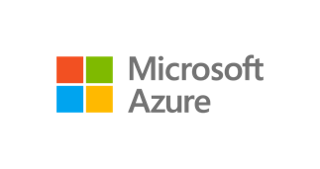
Unified and extensible migration experience
Assess
Migrate
Optimize
Secure & Manage
1st & 3rd party migration tools | Azure migration center | Fastrack for Azure
Azure TCO calculator | Azure Essentials | Azure Expert MSPs | Systems integrators
Notes:
Talking points
Land vision
Migration is a journey. <Click> There is point A (i.e., on-premises source) and point B (i.e., Azure destination). Workloads – i.e., applications, databases, data, servers – needs to move from A to B.
We are making key investments to help customers be successful with the move:
<Click> Repeatable process & tooling to added workload specific as well as wholesale datacenter migration. Provide specific examples – e.g., we have tools to assess and move servers, tools to migrate data at
large scale, tools to migrate databases at scale etc. And we’re agnostic to 1st party vs. 3rd party tools. Our goal is to get customers to Azure.
<Click> DIY resources to help customers build their business case, have the right scenario guidance, and build the right cloud skills: TCO analysis, Azure migration center, Azure Essentials training
<Click> Assist models: Customer success programs like FastTrack/JumpStart along with a rich migration partner ecosystem

Slide 10
The journey to the cloud
Modernization – future-proofing your applications
On-premises
b
Applications
Migration &
Modernization
Cloud-Native
modernization
Cloud-native
SaaS
Data + intelligence
Data reality
Rehost
Refactor
Rearchitect
Rebuild/New
Replace
Refactor
Rearchitect
Rebuild/New
Infrastructure
Virtual Machines
Containers
App, Data, & AI Services
DevOps
Notes:
Modernizing an application involves some change to application design, but it does not necessarily require wholesale changes to application code.
The application takes advantage of IaaS and potentially PaaS capabilities from a cloud provider while maintaining the existing code strategic to the application's use case.
This approach is particularly interesting for customers looking to unlock advanced cloud benefits even if they are unable or unwilling to change code and rewrite the application.
Modernization is also the preferred approach for customers using multiple cloud providers that are looking for portability across clouds and modern DevOps workflows.

Slide 11
Why modernize?
Address security issues caused by legacy code
Dynamically scale apps to meet changing demand
Create intelligent application experiences that enable new business opportunities
Security
Scale
Innovation
Deliver apps and features faster
Modernization triggers
Share business logic and code across platforms
Agility
Productivity
Notes:
There are quite a few triggers for modernization, but it essentially comes down to two main motivations: breathing new life into an existing application or extending a legacy application by adding new functionality.

Slide 12
Modernizing with managed services
Challenges
Azure Benefits
Infrastructure management slows down business processes.
Managed services let you focus on apps, not admin and speed up deployments.
Inefficient resource management.
Smaller instances Increase packing density and improve resource utilization.
Lock-in to a limited (legacy) stack.
Lack of portability across clouds.
Managed services support all stacks.
Containers run on any cloud.
Deployment not automated, slow, wasted time due to manual tasks.
Fast and agile app deployment with built-in DevOps and instant startup.
Production infrastructure can not be replicated on developer machines.
Environments are consistent across development, test and production.
Notes:
Some of the most common business challenges we see when self-hosting applications or web sites can be addressed by moving to Azure managed services.
Keeping applications up and running 24/7 and guaranteeing a consistent level of performance can be a challenge – for example if your marketing campaigns go viral suddenly and your web servers comes crashing down.
Azure solves this problem with built-in autoscaling, failover and load balancing.
Another common challenge is that it might take a long time to get new content, updates and fixes out to customers and users.
Azure solves that with out-of-the box DevOps capabilities that let you deliver faster.
Or, maybe your IT department is already stretched to the limit and spends most of the time administering systems – Azure can handle that for you too, so your IT resources can focus on new digital value creation instead.
Finally, if you are running ASP.NET applications you can move them right over to Azure and continue to use your existing skills, frameworks and tools.

Slide 13



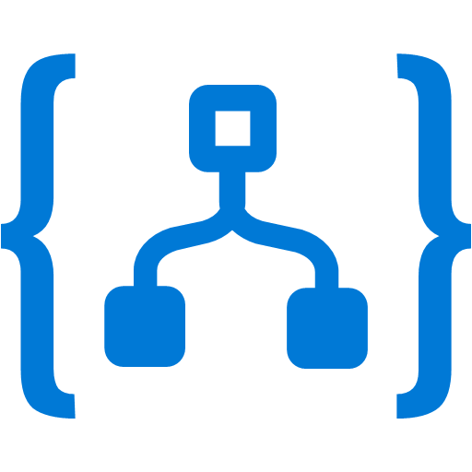
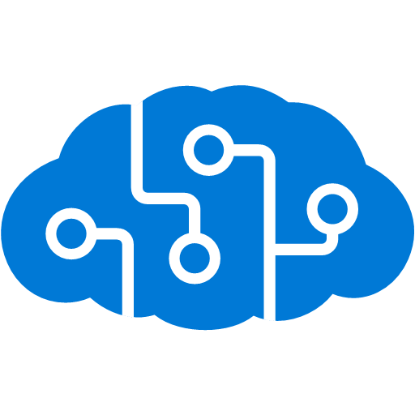
Future-proofing applications with serverless
Adding new capabilities to existing applications
Existing code and functionality is left as-is and moved to the cloud.
New capabilities are added incrementally using serverless functions and triggered by events.
Existing web application
New cloud-native capabilities
Updates per check-in and check-out.
On DB modified, run Logic App
Check-In
Based on address, use text translator
ASP.NET Website
Event trigger
Customer email sent
WCF Service
Check-Out
Notes:
With Azure, you can build cloud-native apps without provisioning and managing infrastructure using a fully managed platform where scaling, availability, and performance are handled for you.
Serverless computing is a cloud-computing execution model in which the cloud provider dynamically manages the allocation of machine resources.
Pricing is based on the actual amount of resources consumed by an application.
This approach allows developers to focus on code without distractions – if they do not have to think about infrastructure, they will be more productive.
Serverless is optimized for any scenario where logic needs to be run in response to an event – and this definition encompasses a lot of application scenarios.
For legacy applications, serverless offers an attractive way to extend the functionality of an existing application without touching the actual source code which might be undocumented or outdated.
Instead of implementing new functionality in the main application, it’s much easier and faster to surround it with pockets of new functionality using technologies like serverless functions that can be triggered via APIs and events.
This also enables you to use advanced cloud-only capabilities like machine learning or AI with existing legacy applications that were built before such concepts were available.

Slide 14
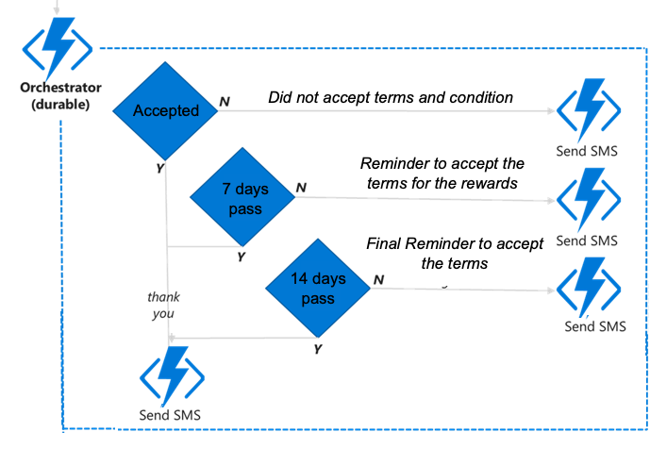

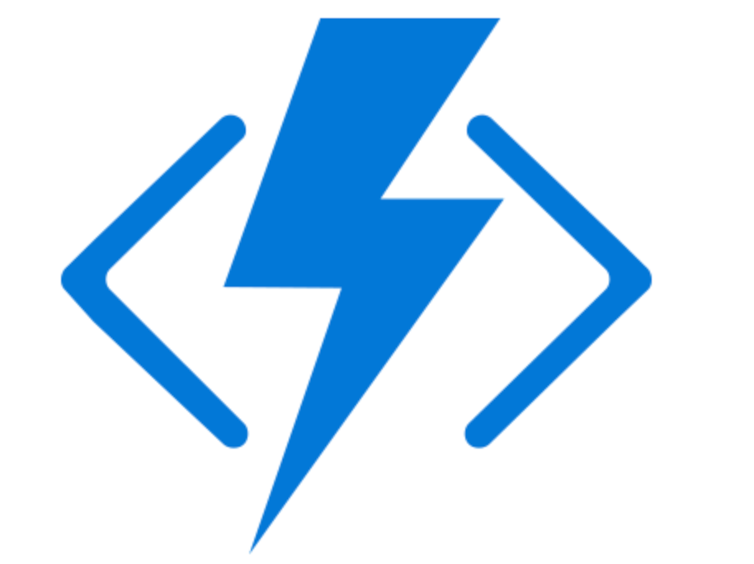
Demo walkthrough – Rewards program
V1 - Migrate to Azure
V2 – Translate emails
V3 – Enroll in royalty program
Logic Apps
App Service
SQL DB
Logic Apps
Azure Functions
Workflow
ASP.NET Website
Updates client information from ASP.NET Site
Triggers based on update to SQL DB and sends translated email
Triggers based on update to SQL DB invoke function
Sends Initial email to client and begins Durable Workflow
DAL Connection to SQL DB
Existing ASP.NET WebForm
Modernized application

Slide 15
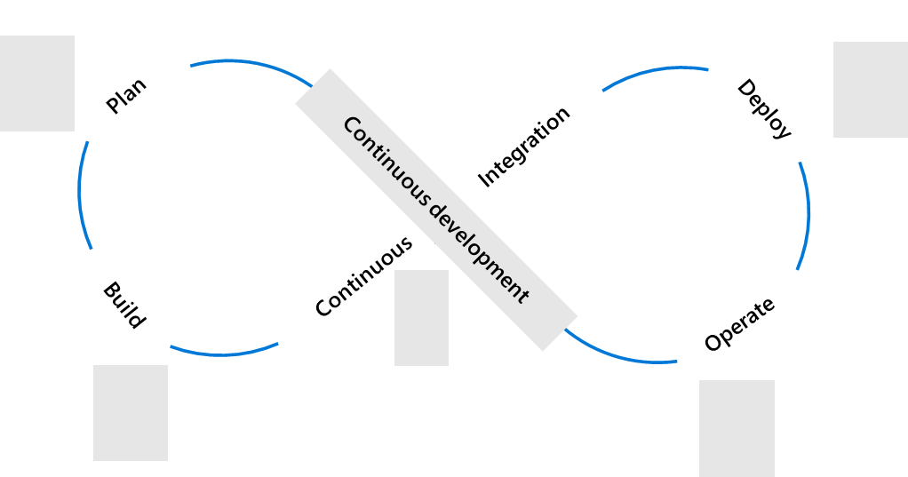
Deliver faster with DevOps
Plan + Track
Release
Development
Operations
Code, Build + Test
Operate + Monitor
Notes:
DevOps is the union of people, process, and tools to enable continuous delivery of value to end users.
The contraction of Dev and Ops refers to replacing silo’ed Development and Operations disciplines with multidisciplinary teams that work together with shared and efficient practices and tools.
A converged DevOps cycle provides the ability to execute on ideas quickly and iterate on feedback rapidly while at the same time maintaining highest levels of quality.
For Microsoft, DevOps encompasses the whole application lifecycle, from idea to application running in production.
DevOps is built into the foundation of Azure, not bolted-on like with other cloud vendors.
Azure DevOps lets you plan smarter, collaborate better, and ship faster with a set of modern developer services.
You can use all the Azure DevOps services or choose just what you need to complement your existing workflows and toolchains.

Slide 16


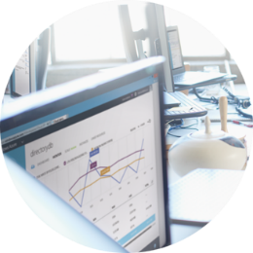
Our journey to DevOps
PM, Dev, Test roles
Personal offices
Deep hierarchy
20+ team sizes
PM & engineering roles only
Team rooms
Flattened hierarchy
8-12 team sizes
People
4-6 month milestones
Features shipped once a year
Success is install numbers Long planning cycles
Secret roadmap
3-week Sprints
Features shipped every Sprint
User satisfaction determines success Continuous planning & learning
Publicly shared roadmap
Process
100 page spec documents
Proprietary SC, TFSVC
Feature branches
Proprietary toolchain
Mockups in PPT
Git
Everyone in master
Azure DevOps
Tools
Notes:
Azure DevOps is built based on our experiences from our own journey to DevOps.
Since 1975, Microsoft has done development a certain way – the waterfall way.
But circa 10 years ago, we saw our business rapidly changing around us – we had to turn our ship around.
Nimble and agile competitors were beginning to eat our lunch.
We quickly realized that our transformation to DevOps would have broad organizational impact.
Every DevOps conversation needs to focus on people, processes and tools equally, otherwise the transformation will fail.
Our DevOps journey began with gradually changing the way we work.
Over time, we were able to introduce broad mindset changes that everybody in our organization now actively embraces and lives every day.
Today, all of Microsoft has adopted DevOps.

Slide 17
Summary
Different paths – one destination
On-premises
b
Applications
Migration & modernization
Cloud-native
SaaS
Data + intelligence
Rehost
Refactor
Rearchitect
Rebuild/New
Replace
Infrastructure
Virtual Machines
Containers
App, Data, & AI Services
DevOps

Slide 18
Different paths – one destination
Objective | Rehost | Refactor | Rearchitect | Rebuild | Cloud model
Deliver new and breakthrough capabilities faster Optimize for developer productivity, build apps faster |  |  |  |  | PaaS
Enable multichannel access, including mobile and IoT Enable secure access to apps and data, on a wide range of devices |  |  |  |  | PaaS
More easily integrate with other web and cloud apps Leverage PaaS, increase productivity with serverless |  |  |  |  | PaaS
Enable business agility with continuous innovation Increase agility across teams and deliver better software, faster |  |  |  |  | PaaS
Meet scalability requirements of existing apps cost effectively Optimize application architecture for cloud scale |  |  |  |  | PaaS
Leverage existing investments Across DevOps, developer tooling, management, infrastructure and app services |  |  |  |  | PaaS
Free up data center space quickly Free up/consolidate resources for apps that must reside on-premises |  |  |  |  | IaaS
Reduce capital expenditure of existing applications Switch to pay-as-you-go model, realize better budget forecasting |  |  |  |  | IaaS
Achieve rapid time to cloud Allow migration with minimal architectural impact |  |  |  |  | IaaS

Slide 19
Resources
Slides – github.com/mbcrump/vslive2019
Demos – aka.ms/tailwindtraders
Email me at Michael.Crump@Microsoft.com for any additional questions.

